Slide 1
Chapter 9. Search
Search definition
Searching sorted arrays
Searching with Self-organizing lists
Searching in Sets
Searching with Hashing
再次复习:6,10-12,21-24,36,43,44,46,50,52,53,61,64

Slide 2
Search
Given: Distinct keys k₁, k₂, …, k_{n} and collection T of n records of the form
(k₁, I₁), (k₂, I₂), …, (k_{n}, I_{n})
where I_{j} is the information associated with key k_{j} for 1 ≤ j ≤ n.
Search Problem: For key value K, locate the record (k_{j}, I_{j}) in T such that k_{j} = K.

Slide 3
Successful vs. Unsuccessful
A successful search is one in which a record with key k_{j} = K is found.
An unsuccessful search is one in which no record with k_{j} = K is found (and no such record exists).

Slide 4
Approaches to Search
1.Search data stored in lists. (this chapter)
  Searching sorted arrays
  Searching with Self-organizing lists
  Searching in Sets
  Searching with Hashing
2. Tree indexing methods. (next chapter)

Slide 5
Search
Search definition
Searching sorted arrays
Searching with Self-organizing lists
Searching in Sets
Searching with Hashing

Slide 6
Searching Ordered Arrays
Sequential Search
Binary Search
Dictionary Search

Slide 7
Search
Search definition
Searching sorted arrays
Searching with Self-organizing lists
Searching in Sets
Searching with Hashing

Slide 8

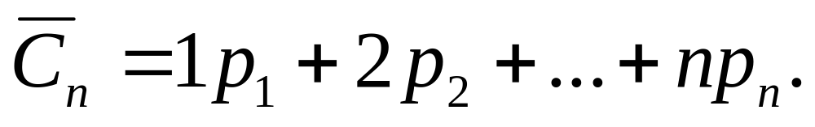
If we can organize the list in order of accessing frequency of the records, sequential search of the list is efficient.
Cost:
  Cost to access first record: 1
  Cost to access second record: 2
  Expected search cost:

Slide 9
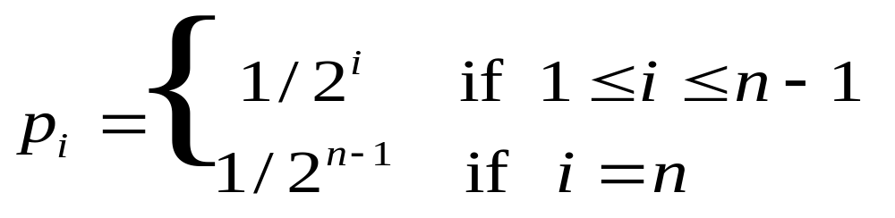
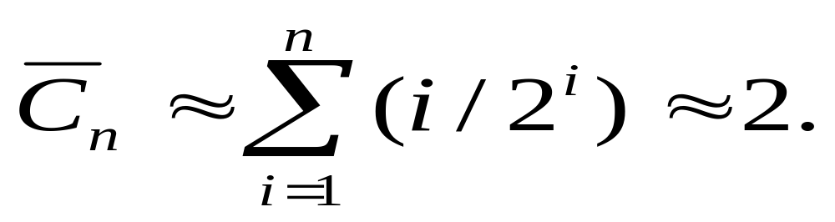
Example
Exponential Frequency
Notes:
2nd line of definition is to make the probabilities sum to 1.

Slide 10
Self-Organizing Lists
Self-organizing lists: The order of records within the list is organized based on the actual pattern of record accesses.
Frequently accessed records are placed at the front of the list.
How to implement?
Self-organizing lists use some heuristics (启发式规则,经验规则) to organize the list.
Notes:
Buffer pools are an example of a self-organizing list.

Slide 11
Heuristics
Count Heuristic: Ordered by the actual frequency of historical access.
Move-to-Front Heuristic : When a record is found, move it to the front of the list.
Transpose Heuristic : When a record is found, swap it with the record ahead of it.
Application:
File compression coding
Notes:
Move to front and transpose are both good. But, here are a few observations:
Move-to-front is not worse than twice “best arrangement”.
Transpose bad example: Keep swapping the last two elements.

Slide 12
Example
Initial sequence: ABCDEFGH
Access pattern: FDFGEGFADFGE
Organized by Count Heuristic:
  FGDEABCH
Organized by Move-to-Front Heuristic:
  EGFDABCH
Organized by Transpose Heuristic:
  ABFDGECH

Slide 13
Search
Search definition
Searching sorted arrays
Searching with Self-organizing lists
Searching in Sets
Searching with Hashing

Slide 14
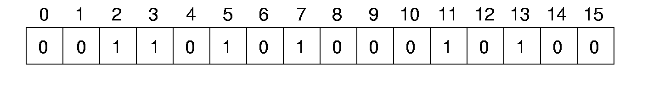
Searching in Sets
Use a bit array to indicate a set.
To judege whether a value is a member of the set, just check the corresponding bit.
How to implement a bit array with more than 32 bits？
Example: Bitmap in BitTorrent clients

Slide 15
Search
Search definition
Searching sorted arrays
Searching with Self-organizing lists
Searching in Sets
Searching with Hashing
        Definition
        Hash Function
        Collision resolution
        Implementation
        Analysis of performance

Slide 16
Hashing (1)
Hashing（散列，哈希）: The process of mapping a key value to a position storing the record in a table.
Hash function: Addr = h (k)
Addr
( k, I )
Data: (key, value)
Hash Table (HT)

Slide 17
Simple Examples (1)
(1) Store the n records with keys in range 0 to n-1.
  Store the record with key i in slot i.
  Use hash function h(K) = K.
0
1
2
3
K=0
K=1
K=2
Hash Table (HT)
K=3
h (k) = k

Slide 18
Simple Examples (2)
(2) More reasonable example:
  Store about 1000 records with keys in range 0 to 16,383.
  If we adopt the hash function h(K) = K，we need to maintain a hash table with 16,384 slots.
  Better solution: Devise a hash function to map the key range to a smaller table.

Slide 19
Search
Search definition
Searching sorted arrays
Searching with Self-organizing lists
Searching in Sets
Searching with Hashing
        Definition
        Hash Function
        Collision resolution
        Implementation
        Analysis of performance

Slide 20
Hash Functions (1)
A hash function MUST return a value within the hash table range.
A hash function SHOULD evenly distribute the records stored among the hash table slots.
0
1
2
3
4
5
6
7
h (k)
Hash Table (HT)

Slide 21
Hash function of integer key (1)
Modulo method: (取模法)
h(key) = key % M. (M is the
size of the hash table)
int h(int x) {
return(x % 16);
}
This function is entirely dependent on the lower 4 bits of the key.
3 0000 0011
19 0001 0011

Slide 22
Hash function of integer key (2)
Mid-square method:（平方取中） Square the key value, take the middle r bits from the result as the value of the hash function.
3 0000 0011 3²=9 0000 1001
19 0001 0011 19²=361 10110 1001

Slide 23
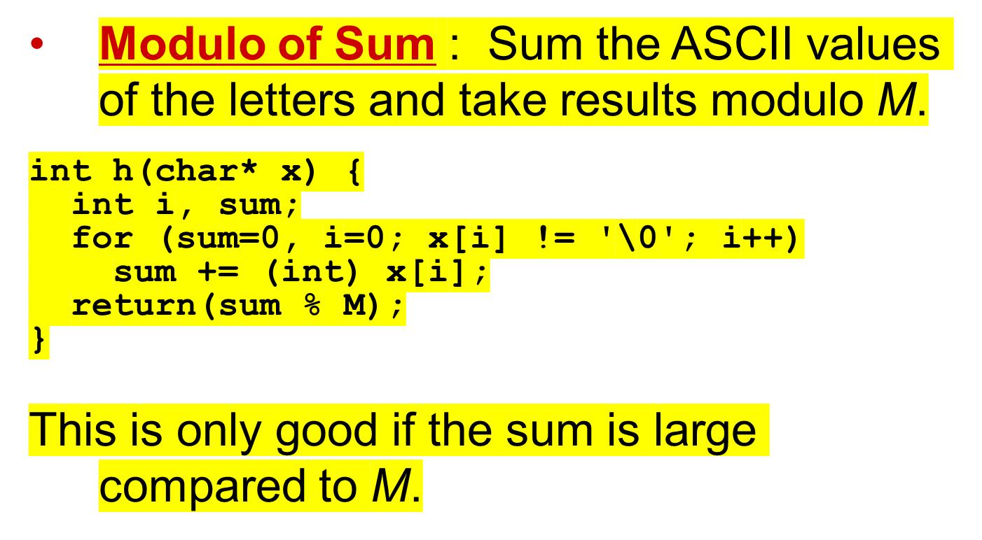
Hash function of string key (1)

Slide 24
Hash function of string key (2)
ELF Hash: used with Executable and Linking Format (ELF) in UNIX System V Release 4.
int ELFhash(char* key) {
unsigned long h = 0;
while(*key) {
h = (h << 4) + *key++;
unsigned long g = h & 0xF0000000L;
if (g) h ^= g >> 24;
h &= ~g;
}
return h % M;
}
key
h

Slide 25
Hash function of string key (2)
ELF Hash: used with Executable and Linking Format (ELF) in UNIX System V Release 4.
int ELFhash(char* key) {
unsigned long h = 0;
while(*key) {
h = (h << 4) + *key++;
unsigned long g = h & 0xF0000000L;
if (g) h ^= g >> 24;
h &= ~g;
}
return h % M;
}
key
h

Slide 26
Hash function of string key (2)
ELF Hash: used with Executable and Linking Format (ELF) in UNIX System V Release 4.
int ELFhash(char* key) {
unsigned long h = 0;
while(*key) {
h = (h << 4) + *key++;
unsigned long g = h & 0xF0000000L;
if (g) h ^= g >> 24;
h &= ~g;
}
return h % M;
}
key
h

Slide 27
Hash function of string key (2)
ELF Hash: used with Executable and Linking Format (ELF) in UNIX System V Release 4.
int ELFhash(char* key) {
unsigned long h = 0;
while(*key) {
h = (h << 4) + *key++;
unsigned long g = h & 0xF0000000L;
if (g) h ^= g >> 24;
h &= ~g;
}
return h % M;
}
key
h

Slide 28
Hash function of string key (2)
ELF Hash: used with Executable and Linking Format (ELF) in UNIX System V Release 4.
int ELFhash(char* key) {
unsigned long h = 0;
while(*key) {
h = (h << 4) + *key++;
unsigned long g = h & 0xF0000000L;
if (g) h ^= g >> 24;
h &= ~g;
}
return h % M;
}
key
h

Slide 29
Hash function of string key (2)
ELF Hash: used with Executable and Linking Format (ELF) in UNIX System V Release 4.
int ELFhash(char* key) {
unsigned long h = 0;
while(*key) {
h = (h << 4) + *key++;
unsigned long g = h & 0xF0000000L;
if (g) h ^= g >> 24;
h &= ~g;
}
return h % M;
}
key
h

Slide 30
Hash function of string key (2)
ELF Hash: used with Executable and Linking Format (ELF) in UNIX System V Release 4.
int ELFhash(char* key) {
unsigned long h = 0;
while(*key) {
h = (h << 4) + *key++;
unsigned long g = h & 0xF0000000L;
if (g) h ^= g >> 24;
h &= ~g;
}
return h % M;
}
key
h

Slide 31
Hash function of string key (2)
ELF Hash: used with Executable and Linking Format (ELF) in UNIX System V Release 4.
int ELFhash(char* key) {
unsigned long h = 0;
while(*key) {
h = (h << 4) + *key++;
unsigned long g = h & 0xF0000000L;
if (g) h ^= g >> 24;
h &= ~g;
}
return h % M;
}
key
h

Slide 32
Hash function of string key (2)
ELF Hash: used with Executable and Linking Format (ELF) in UNIX System V Release 4.
int ELFhash(char* key) {
unsigned long h = 0;
while(*key) {
h = (h << 4) + *key++;
unsigned long g = h & 0xF0000000L;
if (g) h ^= g >> 24;
h &= ~g;
}
return h % M;
}
key
h

Slide 33
Search
Search definition
Searching sorted arrays
Searching with Self-organizing lists
Searching in Sets
Searching with Hashing
        Definition
        Hash Function
        Collision resolution
        Implementation
        Analysis of performance

Slide 34
Collisions
Given: hash function h with keys k₁ and k₂. β is a slot in the hash table.
If h(k₁) = β = h(k₂), then k₁ and k₂ have a collision at β under h.
0
1
2
3
4
5
6
7
h (k)
Hash Table

Slide 35
Collision resolution
What to do when collisions occur?
Open Hashing(链表延长)
Closed Hashing (all elements store in the slots)

Slide 36
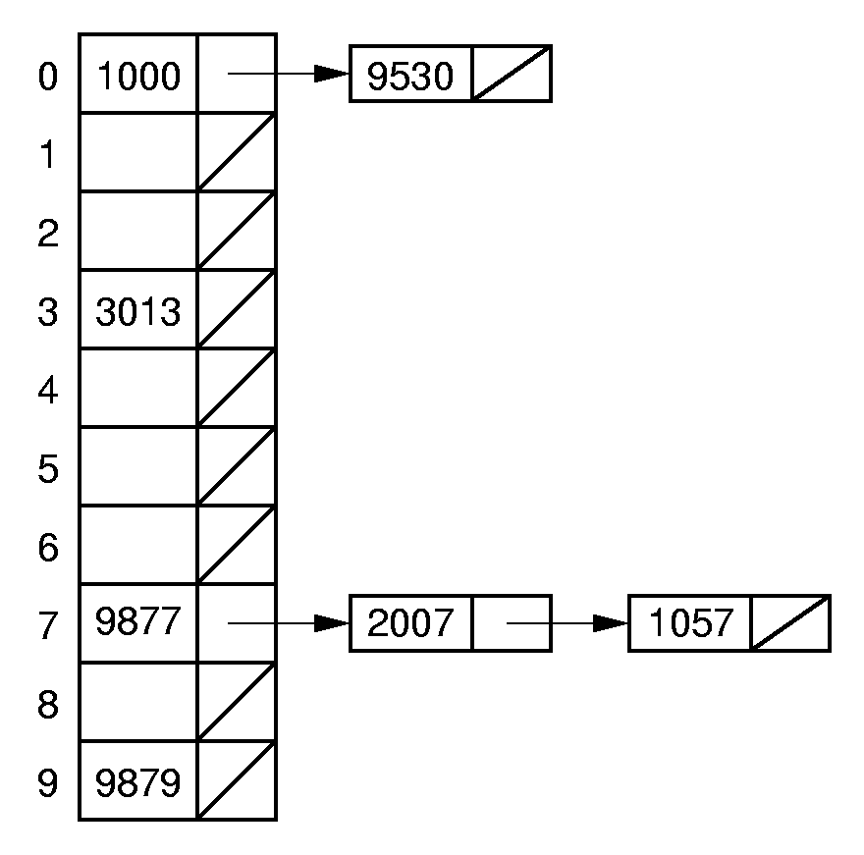
Open Hashing
Open hashing treats each hash table slot as a bin.
Hash Table

Slide 37
Collision resolution
What to do when collisions occur?
Open Hashing
Closed Hashing

Slide 38
Closed Hashing
Closed hashing stores all records directly in the hash table.
Each record i has a home position h(k_{i}).
If another record occupies i’s home position, then another slot must be found to store i.
The new slot is found by a collision resolution policy.
h(k)
xxx
Collision resolution policy

Slide 39
Collision resolution
What to do when collisions occur?
Open Hashing
Closed Hashing
  Bucket Hashing
  Linear Probing
  Improved Linear Probing

Slide 40
Bucket Hashing （桶hash）
Divide the hash table slots into buckets.
Insert a record into the bucket with the
id = h(k)
If the bucket is full, insert the record into a overflow bucket.
h(k)
0
1
2
3
xxx
overflow

Slide 41
Bucket Hashing （2）
When searching, first check the proper bucket. Then check the overflow.
0
1
2
3
overflow
xxx
h(k)

Slide 42
Collision resolution
What to do when collisions occur?
Open Hashing
Closed Hashing
  Bucket Hashing
  Linear Probing

Slide 43
Probe function
0
1
2
3
4
5
M-1
a
Probe function:
h(k)
p(k,1) =2
p(k,2) =4
c
b
…
…
f
The NO. i position to probe after collision:
Pos(i) = ( h(k) + p(k,i) )% M

Slide 44
Linear Probing
Use the following probe function:
p(K, i) = i;
0
1
2
3
4
5
M-1
a
d
  Past bottom,
  wrap around to the top.
h(k)
c
b
…
f
Pos(i) = ( h(k) + p(k,i) ) % M

Slide 45
Existing Problems for Linear Probing
Primary Clustering problems
Secondly Clustering problems

Slide 46
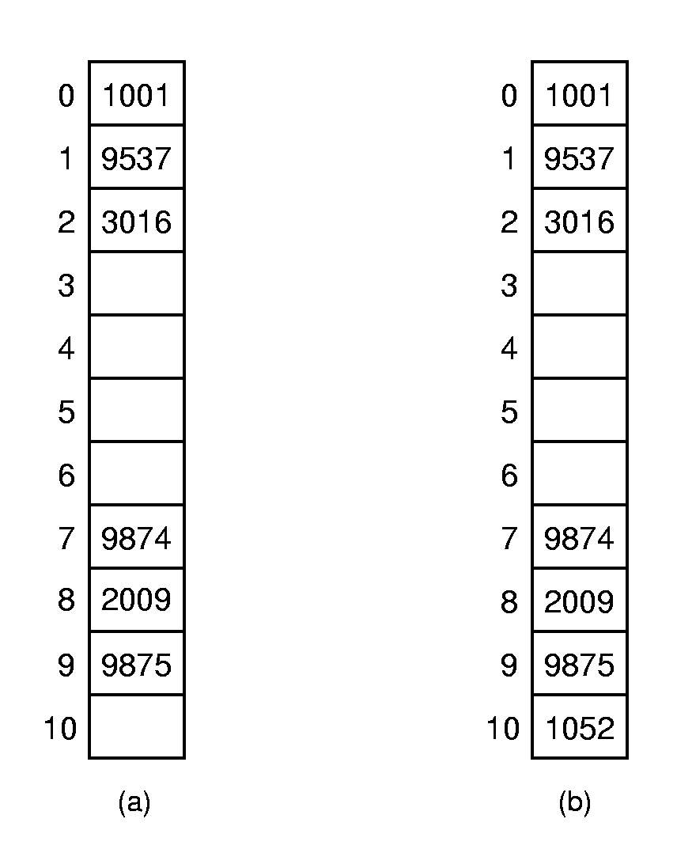
Primary Clustering problems
Primary Clustering: Records tend to cluster in the table with linear probing.
Prob(i): the probability for the next coming data inserted at the pos i.
For (a): prob(3) = 4/11, prob(4) = 1/11, prob(5) = 1/11, prob(6) = 1/11, prob(10) = 4/11.
For(b): prob(3) = 8/11, prob(4,5,6) = 1/11 each.
Notes:
For (a): prob(3) = 4/11, prob(4) = 1/11, prob(5) = 1/11, prob(6) = 1/11, prob(10) = 4/11.
For(b): prob(3) = 8/11, prob(4,5,6) = 1/11 each.

Slide 47
Solution1: Improved Linear Probing
Use the following probe function:
p(K, i) = i*c;
There is still some clustering
  Ex: c=2, h(k₁) = 3; h(k₂) = 5.
  Probe sequence for k₁: 3,5,7,9,11,….
  Probe sequence for k₂: 5,7,9,11,13,…
  Probe sequences for k₁ and k₂ are linked together.
Notes:
If M=10 and c=2, then we effectively have created 2 hash tables (evens vs. odds).

Slide 48
Solution2: Pseudo-Random Probing(1)
The ideal probe function would select the next slot on the probe sequence at random.
p(K, i) = random();
An actual probe function cannot operate randomly. (Why?)

Slide 49
Solution2 : Pseudo-Random Probing(2)
Select a (random) permutation of the numbers from 1 to M-1:
r₁, r₂, …, r_{M-1}
p(K, i) = r_{i};
Example: Hash table size of M = 101
  r₁=2, r₂=5, r₃=32 …
  h(k₁)=30, h(k₂)=28.
  Probe sequence for k₁:30，32，35，62
  Probe sequence for k₂:28，30，33，60
Notes:
Probe sequence for k₁: 30, 32, 35, 62.
Probe sequence for k₂: 28, 30, 33, 60.

Slide 50
Solution3: Quadratic (二次) Probing
Set the i’th value in the probe sequence as
p(K, i) = i²;
Example: M=101
  h(k₁)=30, h(k₂) = 29.
  Probe sequence for k₁ :30，31，34，39
  Probe sequence for k₂ :29，30，33，38
Notes:
Probe sequence for k₁: 30, 31, 34, 39.
Probe sequence for k₂: 29, 30, 33, 38.

Slide 51
Existing Problems for Linear Probing
Primary Clustering problems
Secondly Clustering problems

Slide 52
Secondary Clustering Problem
If two keys hash to the same slot, they follow the same probe sequence. This is called secondary clustering.(二次聚集)
Example:
  Ex: h(k₁) = 3; h(k₂) = 3; p(K, i) = i²;
  Probe sequence for k₁: 3,4,7,12,19,….
  Probe sequence for k₂: 3,4,7,12,19,…
Notes:
Probe sequence for k₁: 30, 31, 34, 39.
Probe sequence for k₂: 29, 30, 33, 38.

Slide 53
Solution: Double Hashing
p(K, i) = i * h₂(K)
Example: Hash table of size M=101
  h(k₁)=30, h(k₂)=28, h(k₃)=30.
  h₂(k₁)=2, h₂(k₂)=5, h₂(k₃)=5.
  Probe sequence for k₁ is: 30, 32, 34, 36.
  Probe sequence for k₂ is: 28, 33, 38, 43.
  Probe sequence for k₃ is: 30, 35, 40, 45.
Pos(i) = ( h(k) + p(k,i) )% M
Notes:
Probe sequence for k₁: 30, 32, 34, 36.
Probe sequence for k₂: 28, 33, 38,43.
Probe sequence for k₃: 30, 35, 40, 45.

Slide 54
Search
Search definition
Searching sorted arrays
Searching with Self-organizing lists
Searching in Sets
Searching with Hashing
        Definition
        Hash Function
        Collision resolution
        Implementation
        Analysis of performance

Slide 55
Insertion
// Insert e into hash table HT
template <class Key, class Elem>
bool hashInsert(const Elem& e) {
int home; // Home position for e
Key k =getkey(e);
int pos = home = h(k); // Init
for (int i=1; i <= M && HT[pos]!= EMPTY; i++)
{
if (k == getkey(HT[pos]))
return false; // Duplicate
pos = (home + p(getkey(e), i)) % M;
}
if(i > M) return false;
HT[pos] = e; // Insert e
return true;
}
Pos(i) = ( h(k) + P(k,i) )% M
Notes:
1) HASHTABLE满的时候会陷入死循环
2) Home位置没有和key进行比较

Slide 56
Exercise about insertion
Exercise:
A hash table with the length equal to 10.
Hash function: h(K) = k % 10
Collision resolution: Linear probing.
  Probe function: P(k,i) = i
Insert the following integers in order:
  12, 20, 18,28,39,21,8

Slide 57
Search
// Search for the record with Key K
template <class Key, class Elem>
bool hashSearch(const Key& K, Elem& e) const
{
int home; // Home position for K
int pos = home = h(K); // Initial posit
for (int i = 1; i<=M && HT[pos] != EMPTY&&
K != getkey(HT[pos]); i++)
pos = (home + p(K, i)) % M; // Next
if(i > M) return false;
if (K == getkey(HT[pos])) { // Found it
e = HT[pos];
return true;
}
else return false;
// K not in hash table(find a empty slot)
}
Notes:
HASHTABLE满的时候，会死循环

Slide 58
Exercise about search
Exercise:
A hash table with the length equal to 10.
Hash function: h(K) = k % 10
Collision resolution: Linear probing.
  Probe function: P(k,i) = i
Insert the following integers in order:
  12, 20, 18,28,39,21,8
What is the average comparison time to search the elements in the hash table?

Slide 59
Deletion (1)
20
39
12
21
8
18
28
0 1 2 3 4 5 6 7 8 9
Delete 20
h(K) = k % 10
39
12
21
8
18
28
?
0 1 2 3 4 5 6 7 8 9
When search 8 , 8 cannot be found !

Slide 60
Deletion (2)
Deleting a record must not hinder later searches.
We do not want to make positions in the hash table unusable because of deletion.

Slide 61
Tombstones (墓碑) (1)
Both of these problems can be resolved by placing a special mark in place of the deleted record, called a tombstone.
A tombstone will not stop a search, but that slot can be used for future insertions.
20
39
12
21
8
18
28
0 1 2 3 4 5 6 7 8 9
After deletion of 20:
T
39
12
21
8
18
28
0 1 2 3 4 5 6 7 8 9
When search 8 , 8 also can be found !

Slide 62
Tombstones (墓碑) (2)
Unfortunately, tombstones add to the average path length.
Solutions:
Local reorganizations to try to shorten the average path length.
Periodically rehash the table (by order of most frequently accessed record to the right position).
T
T
12
T
8
T
T
0 1 2 3 4 5 6 7 8 9
Reorganize
12
8
0 1 2 3 4 5 6 7 8 9

Slide 63
Search
Search definition
Searching sorted arrays
Searching with Self-organizing lists
Searching in Sets
Searching with Hashing
        Definition
        Hash Function
        Collision resolution
        Implementation
        Analysis of performance

Slide 64
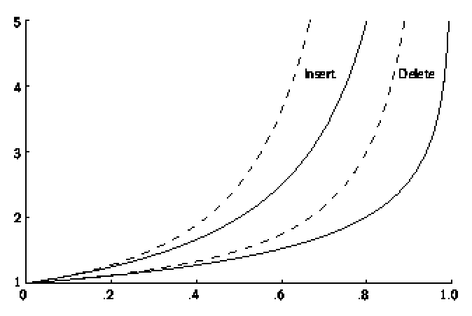
Analysis of Closed Hashing
The load factor is α = N/M where N is the number of records currently in the table.
Expected
number
of
record
accesses
a

